Slide 1

Time Series – Forecasting Furniture Sales
Neelam Chouhan
DSFT - 8

Slide 2
Project Objective
Predict the future sales
Estimate Future trends in terms of sales, profits , gains
Help maintain inventory of the stock.
Will reflect the demand therefore we can strategize it to expand business.

Slide 3
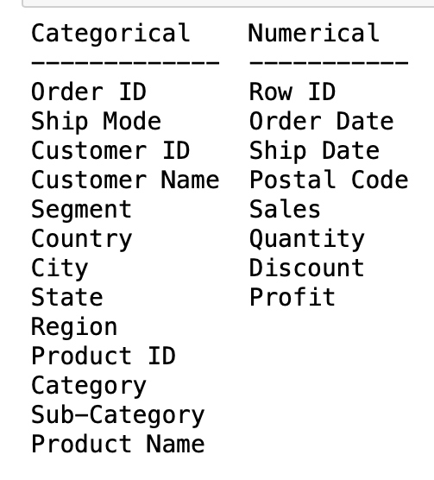
Let’s understand our data.
Data has 2121 rows and 21 columns.
We can see the data types of the various columns, but we will
not be using all these columns.
We have grouped by Order data as there were multiple
entries for the same date and set that as the index.

Slide 4
Workflow Flow Of This Project
Loading the dataset
Understanding the data and get some domain knowledge.
Data Decomposition
Stationarity Check.
ACF and PACF.
Splitting the data
Model Building using various Algorithms
Model Selection
Inferences
Forecasting Sales

Slide 5
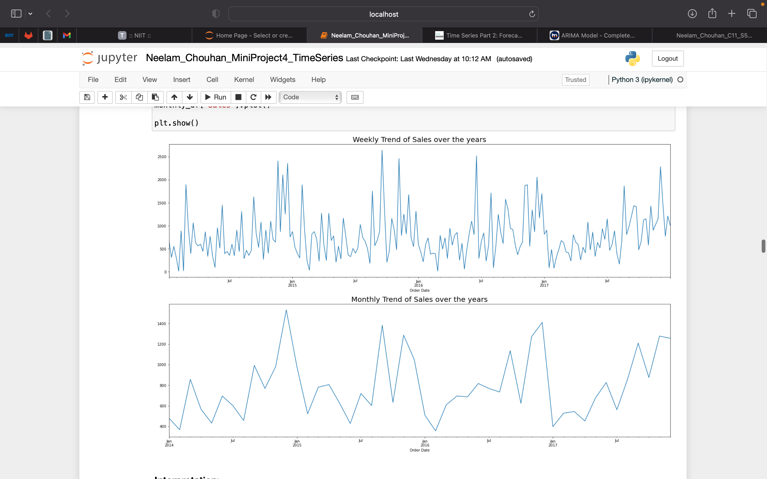
Let us understand the trend. - We can see both trend and seasonality in the sales of furniture. - We can see that December January are the best months in terms of sales and middle of the year is when the sales drop.

Slide 6
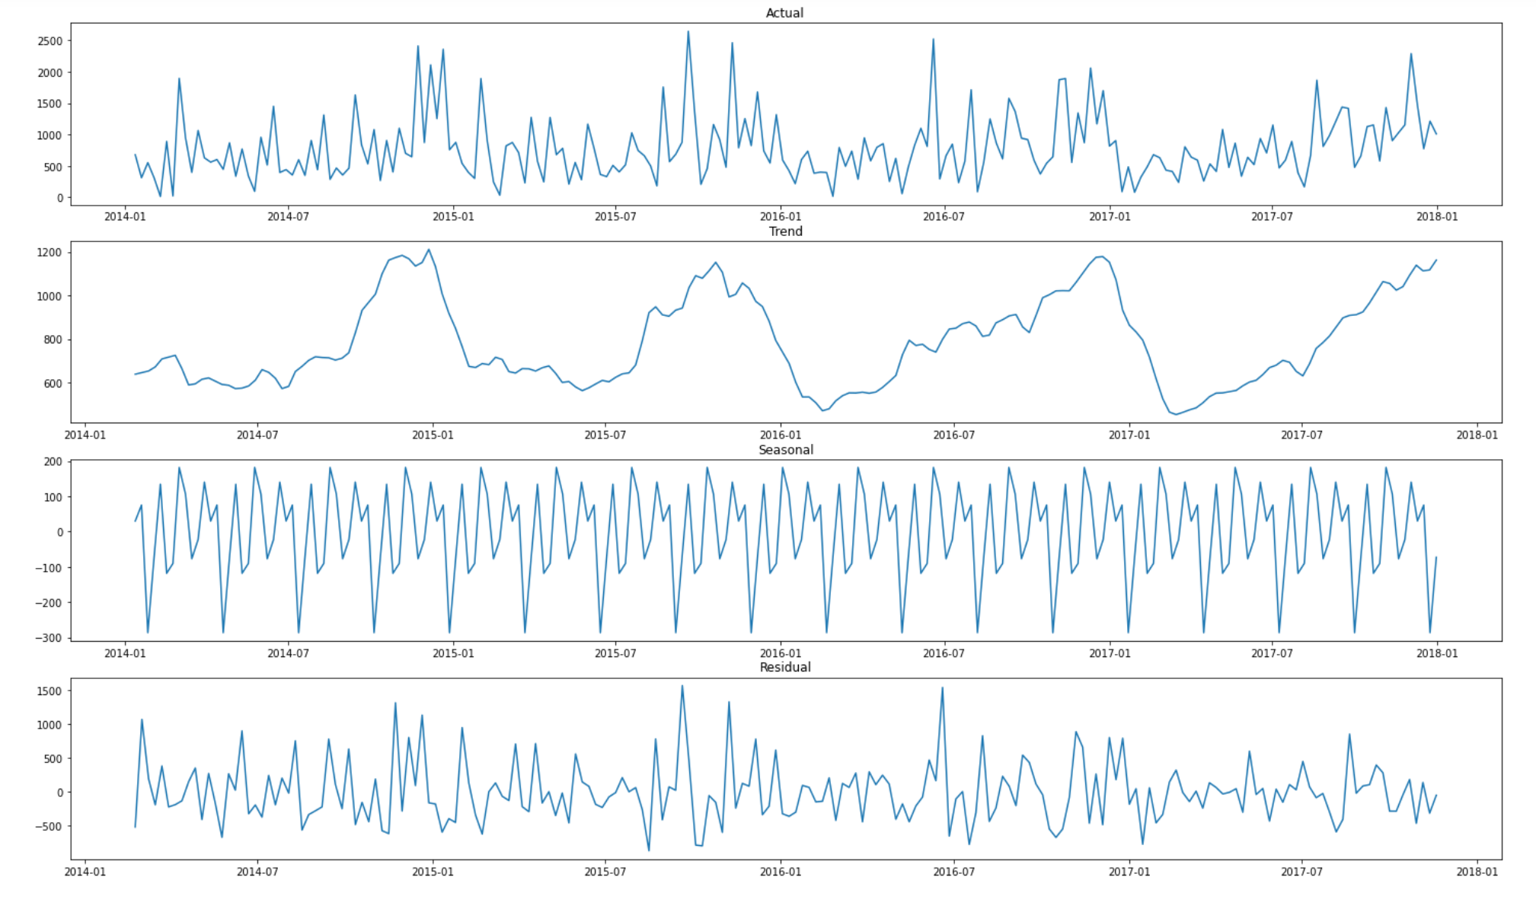
Decomposition - As mentioned in the resampled data we see trend and seasonality. - We also see the presence of residuals in our data.

Slide 7
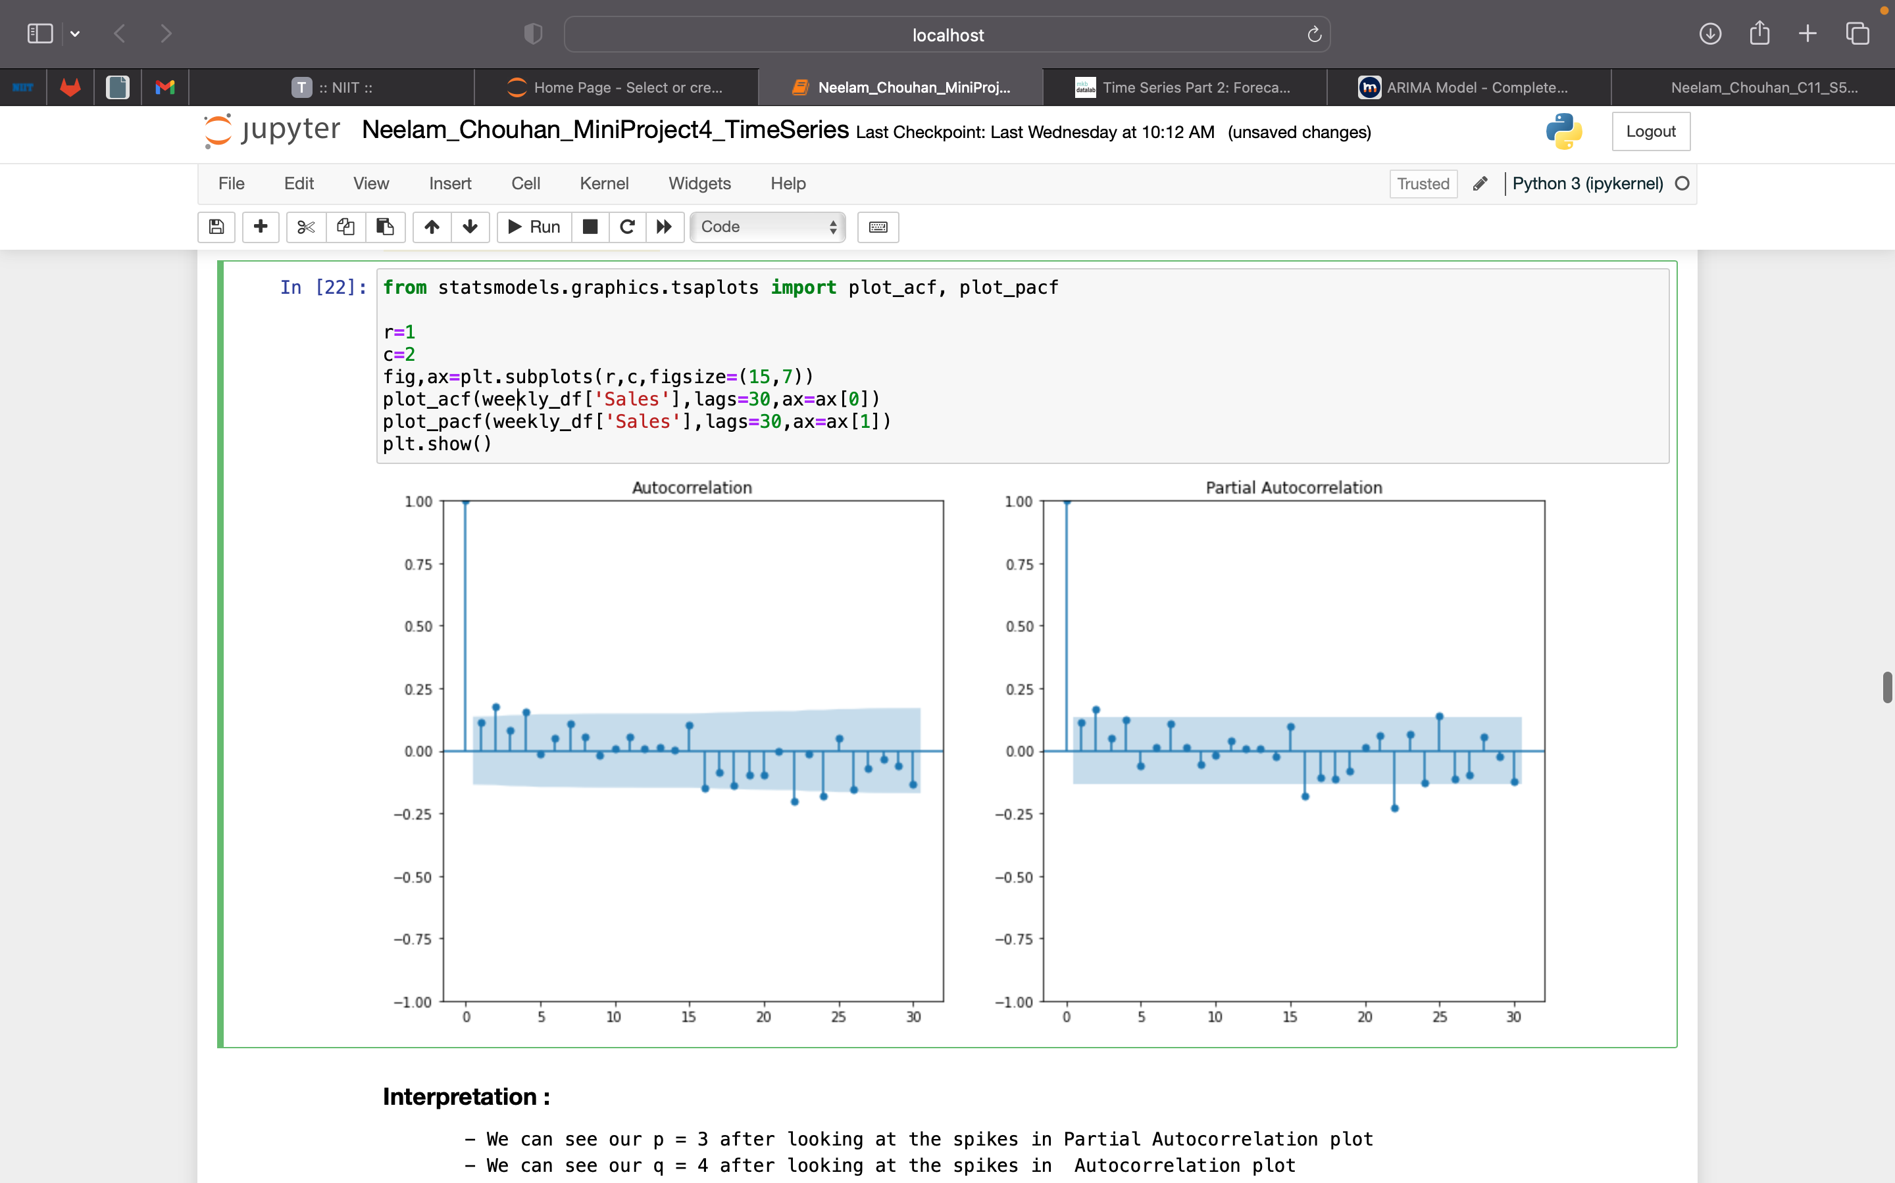
Model Building
Since we have already established the fact that the dataset contains both trend and seasonality, we will be using these models to build our model and forecast the sales values:
SARIMA
SARIMAX
The ACF and PACF plots give us the p = 3 and q =4 .
We will use d = 0 since the data is stationary that we determined by doing the ad fuller test.

Slide 8
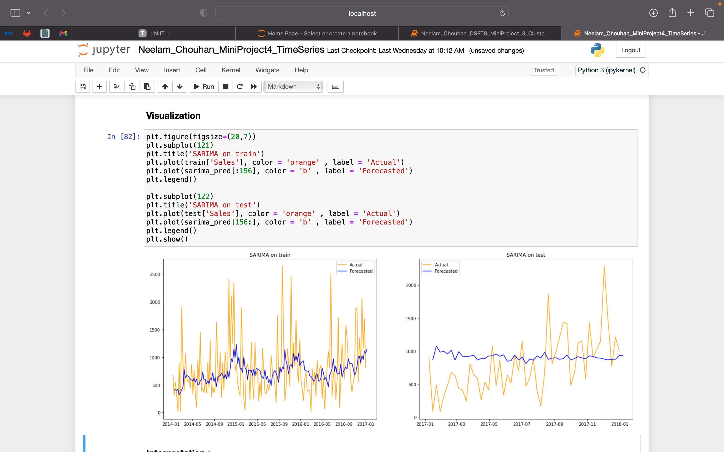
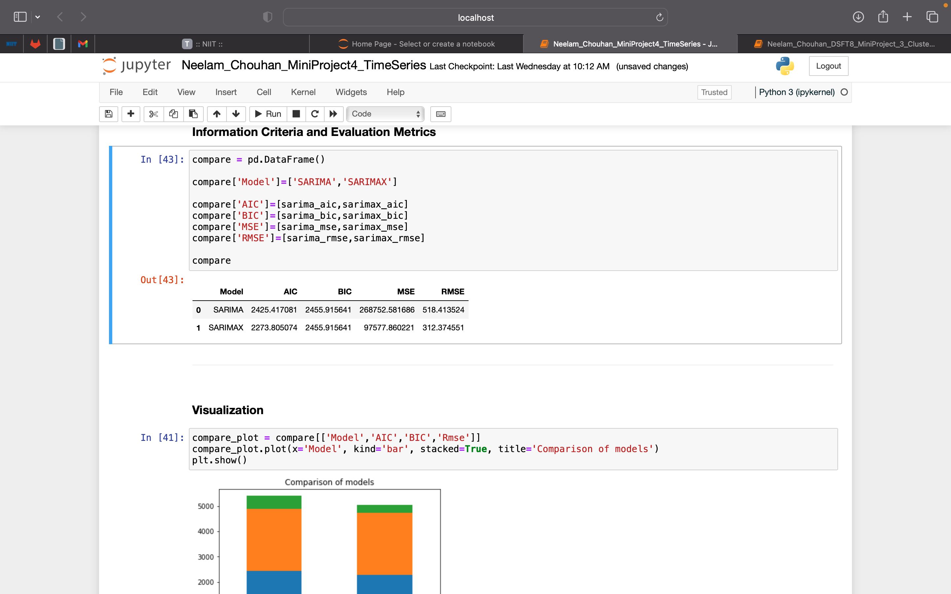
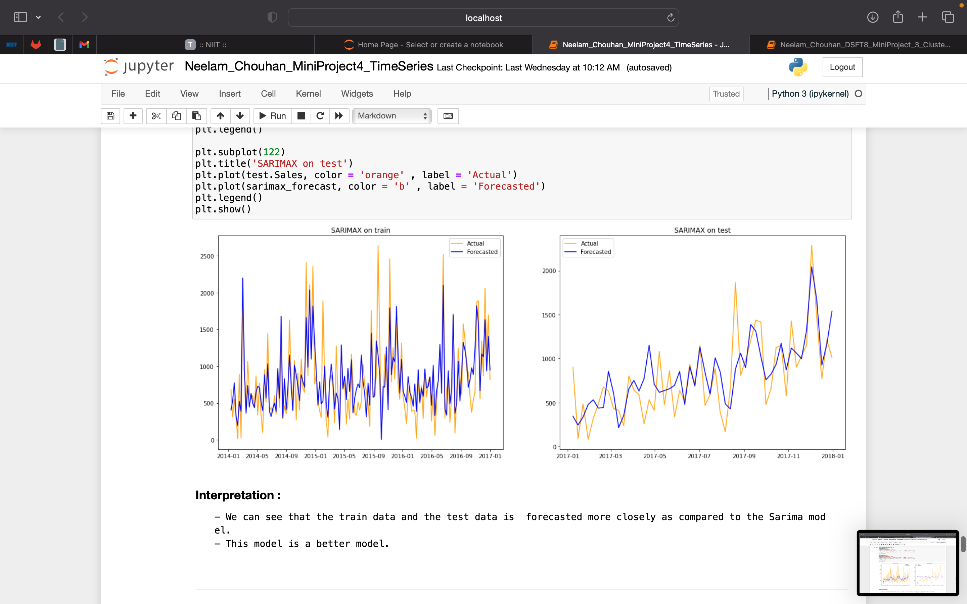
How do we choose the best model?
The information criterions and error scores are lowest for SARIMAX.
We can see that the train data and the test data is forecasted more closely for the SARIMAX model as compared to the SARIMA model.
SARIMAX model is a better model.

Slide 9
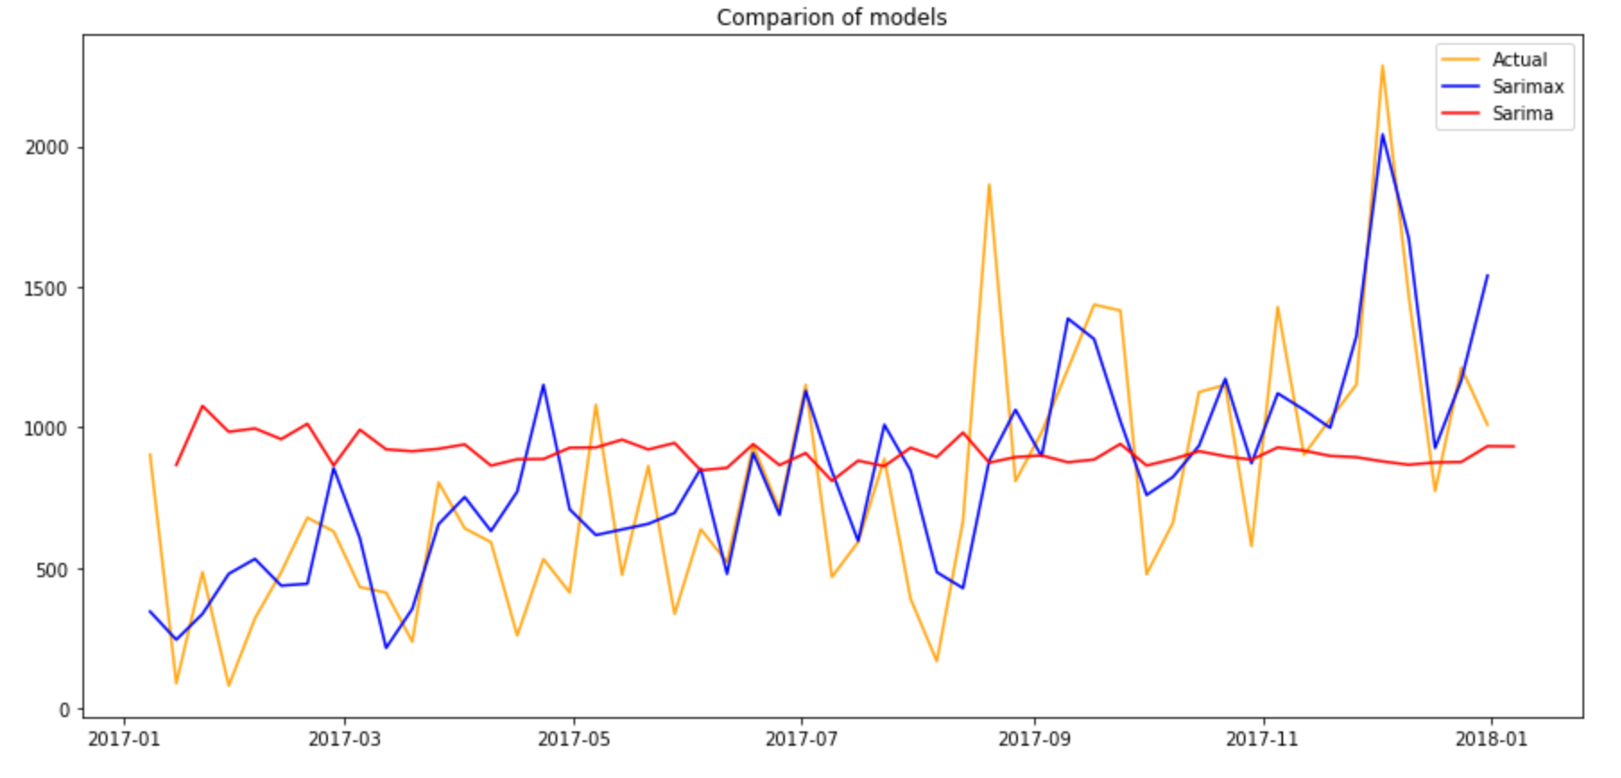
Comparisons of Models.

Slide 10
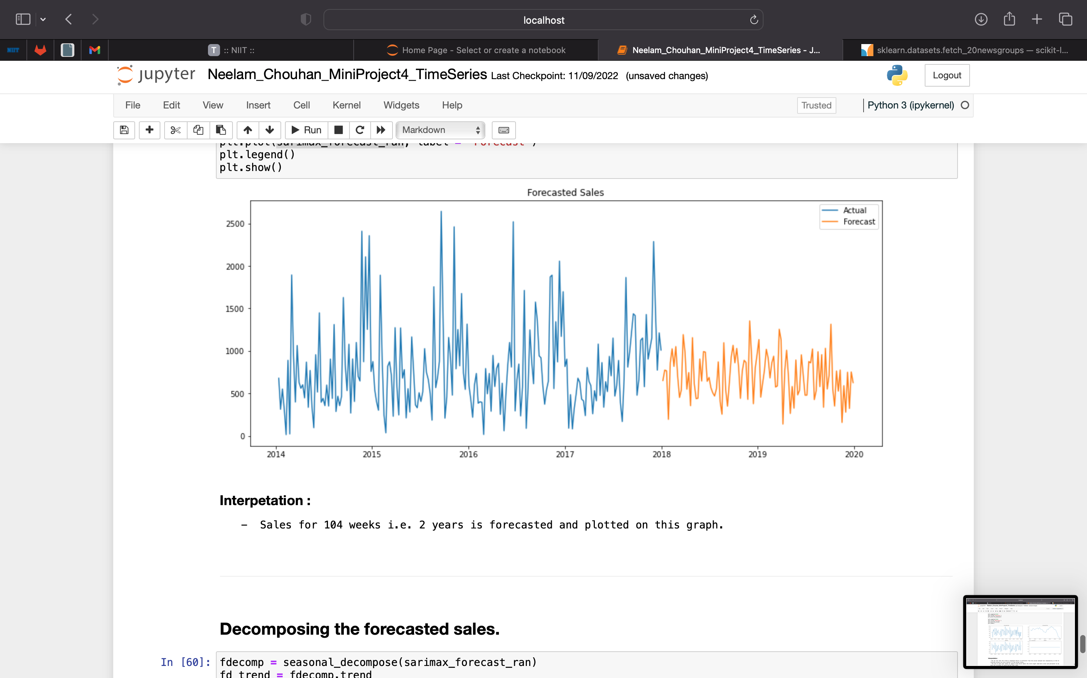
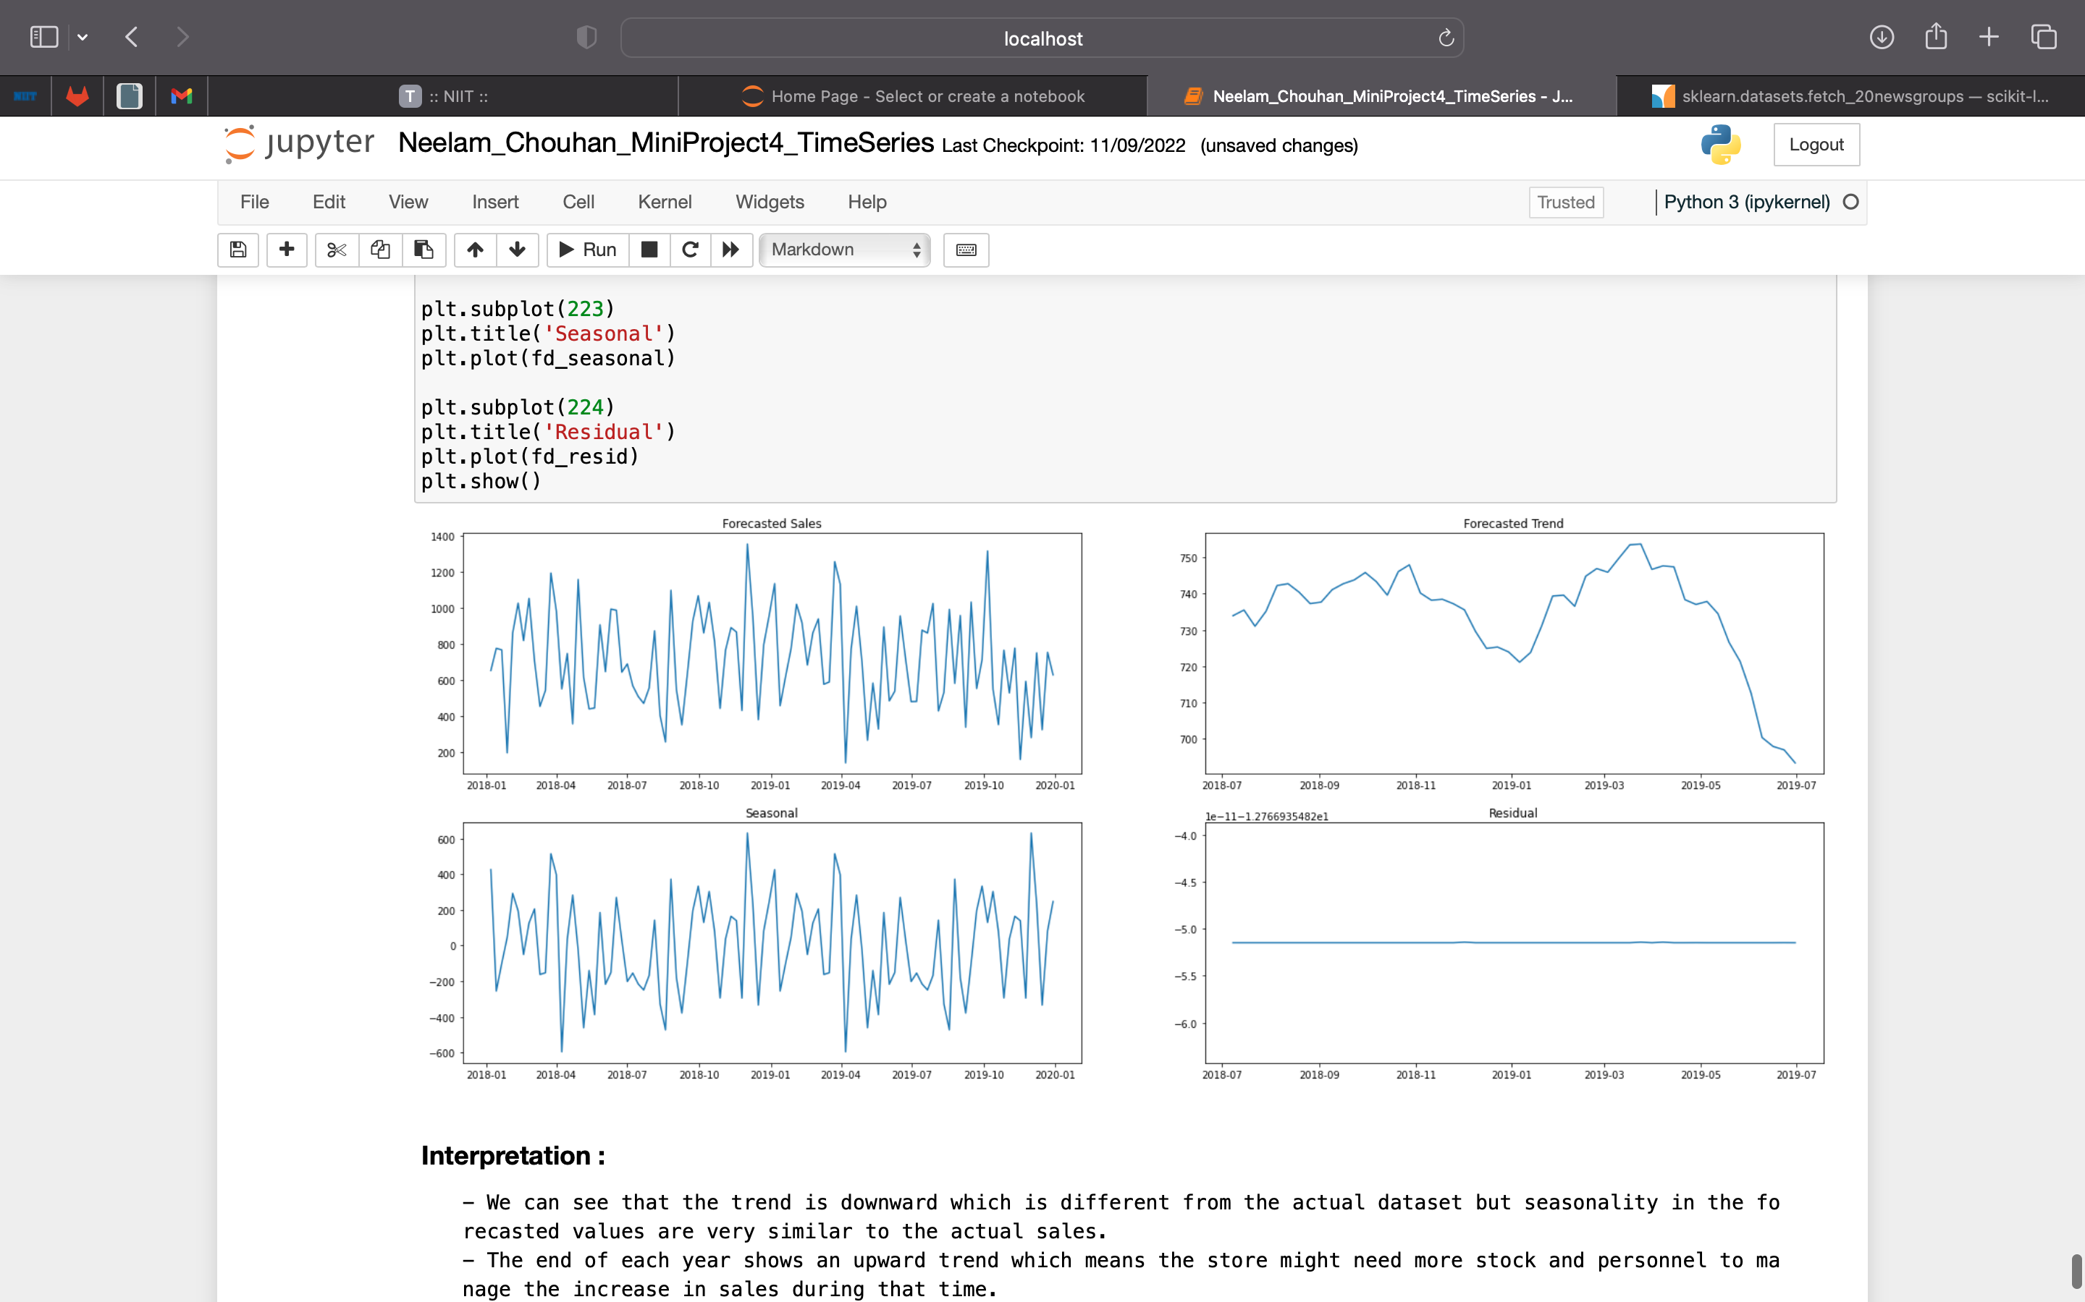
Forecasting Future Sales. Sales for 104 weeks i.e. 2 years is forecasted and plotted on this graph. The values are decomposed to understand the various components of the forecasted sales.

Slide 11
Business Suggestions
We can see that the trend is downward which is different from the actual dataset but seasonality in the forecasted values are very similar to the actual sales.
The end of each year shows an upward trend which means the store might need more stock and personnel to manage the increase in sales during that time.
Introducing end of season sales or some monthly promotional discounts to increase the sales during the dead months.

Slide 12
Thank You

